Slide 1






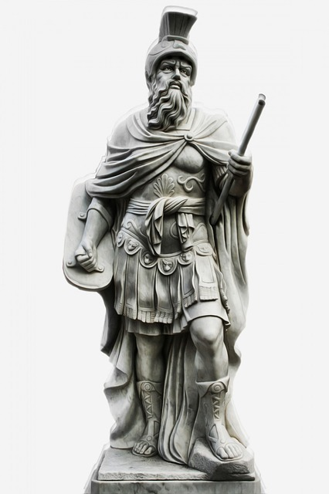















COMPARETALKNSHOP
http://www.url.com
Clothing
Home
Outdoors
Gaming
Collect
Misc
Clothing
Home
Outdoors
Gaming
Collect
Misc
Product information here…
Product information here…

Slide 2
COMPARETALKNSHOP
http://www.url.com
Clothing
Home
Outdoors
Gaming
Collect
Misc
Clothing
Home
Outdoors
Gaming
Collect
Misc
Vendor: Amazon
Product ID: 774433
In-Stock: Yes
Tags: 44
Product information here…

Slide 3
COMPARETALKNSHOP
http://www.url.com
Clothing
Home
Outdoors
Gaming
Collect
Misc
Clothing
Home
Outdoors
Gaming
Collect
Misc
Vendor: Amazon
Product ID: 774433
In-Stock: Yes
Tags: 44
Vendor: Ebay
Product ID: 88747
In-Stock: Yes
Tags: 22

Slide 4
COMPARETALKNSHOP
http://www.url.com
Clothing
Home
Outdoors
Gaming
Collect
Misc
Clothing
Home
Outdoors
Gaming
Collect
Misc
Vendor: Amazon
Product ID: 774433
In-Stock: Yes
Tags: 44
Vendor: Ebay
Product ID: 88747
In-Stock: Yes
Tags: 22

Slide 5
COMPARETALKNSHOP
http://www.url.com
Clothing
Home
Outdoors
Gaming
Collect
Misc
Clothing
Home
Outdoors
Gaming
Collect
Misc
Vendor: Amazon
Price: $55.00
Vendor: Ebay
Product ID: 88747
In-Stock: Yes
Tags: 22

Slide 6
COMPARETALKNSHOP
http://www.url.com
Clothing
Home
Outdoors
Gaming
Collect
Misc
Clothing
Home
Outdoors
Gaming
Collect
Misc
Vendor: Amazon
Price: $55.00
Vendor: Ebay
Product ID: 88747
In-Stock: Yes
Tags: 22

Slide 7
COMPARETALKNSHOP
http://www.url.com
Clothing
Home
Outdoors
Gaming
Collect
Misc
Clothing
Home
Outdoors
Gaming
Collect
Misc
Vendor: Amazon
Price: $55.00
Vendor: Ebay
Tags: statue, replica, collectible, roman

Slide 8
COMPARETALKNSHOP
http://www.url.com
Clothing
Home
Outdoors
Gaming
Collect
Misc
Clothing
Home
Outdoors
Gaming
Collect
Misc
Vendor: Amazon
Price: $55.00
Vendor: Ebay
Tags: statue, replica, collectible, roman

Slide 9
HELP
http://www.url.com
Welcome to the help section! Here you can find information on common ComparativeShopping features as well as our patented data standard.
Back to the site’s homepage
Information on the product
Pricing information on the product
Ordering information on the product
Tag information on the product
Like on Facebook
Send a request to Facebook for a disliek button
Refresh page

